Slide 1
Project One
Randy Ahrendts

Slide 2
Software Settings
Hive and HDFS In UBuntu.
DBeaver in Windows.

Slide 3
Basic Set Up
create table if not exists BBA (drink STRING, branch STRING) row format delimited fields terminated by ',' stored as textfile;
LOAD DATA INPATH '/user/randy/proj1/Bev_BranchA.txt' OVERWRITE INTO TABLE BBA;
create table if not exists Branch1 as select * from bba where branch = 'Branch1'
UNION ALL
select * from bbb where branch = 'Branch1' --pointless since no branch1 in bbb and bbc
UNION ALL
select * from bbc where branch = 'Branch1’;
create table if not exists Branch1drinksT as select a.amount , a.drink from bca a join Branch1 b1 on (b1.drink = a.drink)
UNION ALL
select b.amount , b.drink from bcb b join Branch1 b1 on (b1.drink = b.drink)
UNION ALL
select c.amount , c.drink from bcc c join Branch1 b1 on (b1.drink = c.drink)

Slide 4
Problem Scenario 1
What is the total number of consumers for Branch1?
1,115974
select sum(bal.amount) as Consumers from Branch1drinksT bal;
What is the number of consumers for the Branch2?
5099141
select sum(ba2.amount) as Consumers from Branch2drinks ba2;

Slide 5
Problem Scenario 2
What is the most consumed beverage on Branch1
Special_cappuccino 108163.0
select drink, sum(amount) as most from branch1drinkst group by drink order by most desc limit 1;
What is the least consumed beverage on Branch2
Cold_MOCHA 47524.0
select drink, sum(amount) as most from branch2drinks group by drink order by most ASC limit 1;

Slide 6
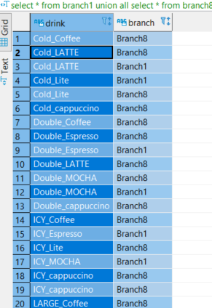
Problem Scenario 3
What are the beverages available on Branch10, Branch8, and Branch1?
Branch10 doesn’t exist
create table if not exists branch8and1 as select * from branch1
union all
select * from branch8;
select * from branch8and1 order by drink limit 20;

Slide 7
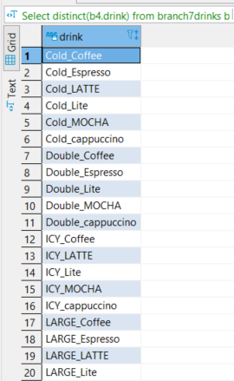
what are the comman beverages available in Branch4,Branch7?
Select distinct(b4.drink) from branch7drinks b7
join Branch4drinks b4
where b4.drink = b7.drink limit 20;

Slide 8
Problem Scenario 4
create a partition,index,View for the scenario 3.
create table b8and1 (
drink STRING ) Partitioned by (branch STRING)
row format delimited fields terminated by ',' stored as textfile;
set hive.exec.dynamic.partition.mode=nonstrict;
insert into table b8and1 Partition(branch) select * from branch8and1;
create Index index_drink on table branch8and1(drink)
AS 'org.apache.hadoop.hive.ql.index.compact.CompactIndexHandler'
WITH DEFERRED REBUILD;
create view b8and1_view AS select * from branch8and1;

Slide 9
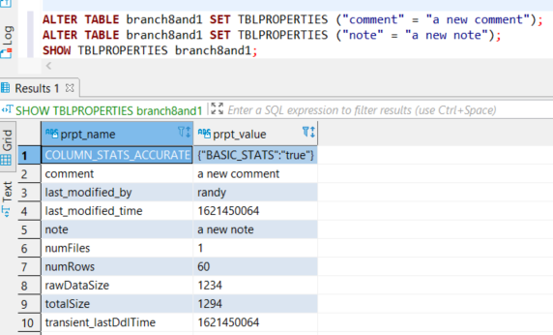
Problem Scenario 5
Alter the table properties to add "note","comment“

Slide 10
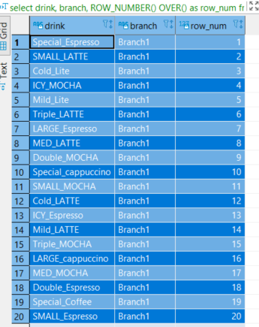
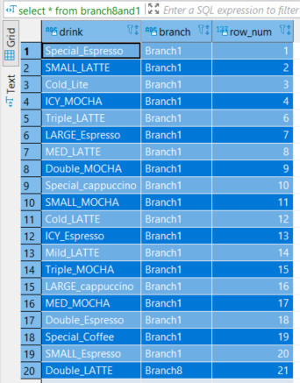
Problem Scenario 6
Remove the row 5 from the output of Scenario 3

Slide 11
alter table branch8and1 ADD COLUMNS (row_num INTEGER);
create table b8and1_tmp like branch8and1;
insert into b8and1_tmp
select drink, branch, ROW_NUMBER() OVER() as row_num
from branch8and1;
insert overwrite table branch8and1
select * from b8and1_tmp t
where not exists (select 1 from branch8and1 tmp
where (t.drink == tmp.drink)
and t.row_num = 5);

Slide 12
Fin

